Slide 1
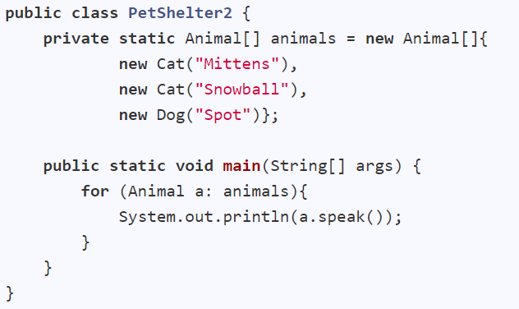
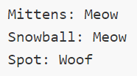
Polymorphism
Treat one type as another and still get the behavior of the actual object
Animal
Cat
Dog
This method is in the Animal class but overridden in the Cat and Dog classes

Slide 2
Dynamic Binding
Overridden methods
speak()
Animal
speak()
Cat
Dog
speak()
Same message
Overloaded methods
Determined at runtime
Static Binding

Slide 4
Animal
Cat
Dog

Slide 5
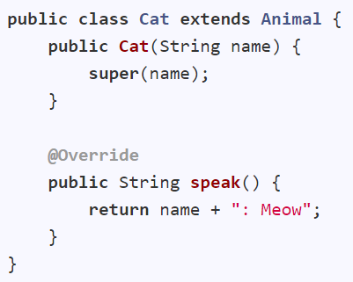
Abstract classes/methods
Animal
public class Animal {
protected string name;
public Animal(String name) {
this.name = name;
}
public String speak() {
return null;
}
}
Cat
Dog

Slide 6
Abstract classes/methods
Animal
public abstract class Animal {
protected string name;
public Animal(String name) {
this.name = name;
}
public String speak() {
return null;
}
}
This method implementation should always be overridden
Cat
Dog
public abstract String speak();
It can be declared as abstract
Abstract classes cannot be instantiated but can be used as a type.
Animal a; //OK
a = new Cat(“Kitty”); //OK
a = new Animal(“Foo”); //Not OK
What if this method is removed?

Slide 8
move()
Mobile
eat()
sound()
Animal
Vehicle
Cat
Dog
Coral
…
Car
Bike
…
eat()
eat()
eat()
sound()
sound()
sound()

Slide 9
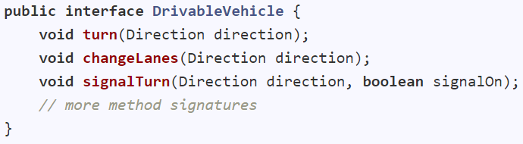
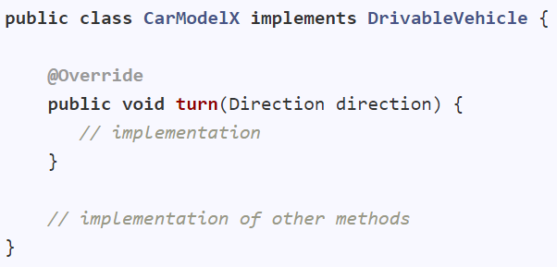
Interfaces
A behavior specification.

Slide 10
move()
<<interface>>
Mobile
eat()
sound()
Animal
Vehicle
Cat
Dog
Coral
…
Car
Bike
…
eat()
eat()
eat()
sound()
sound()
sound()

Slide 11
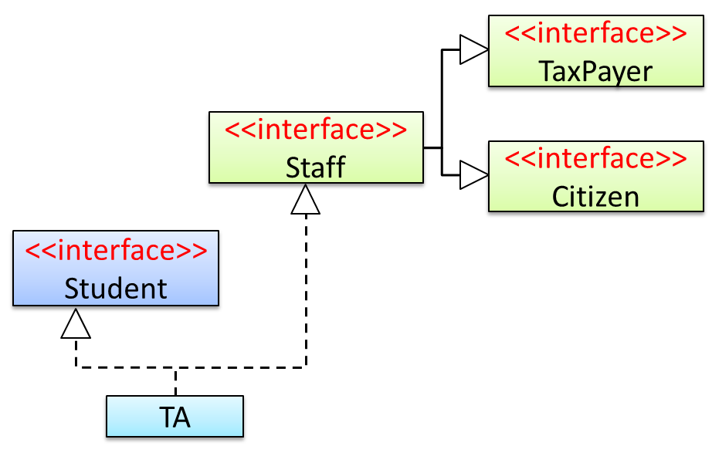
Interfaces
Multiple inheritance allowed.
Person
interface Staff extends TaxPayer, Citizen {
//…
}
class TA extends Person implements Student, Staff {
//…
}
A TA object is a Person, Student, Staff, TaxPayer, Citizen

Slide 12
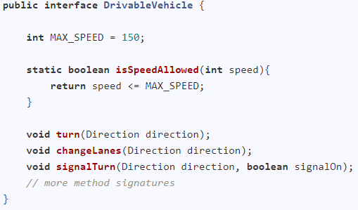
Interfaces
Can have constants, static methods, (and default methods, nested types)
Constant
Static method

